Slide 1
Braceloc project

Slide 2
Summary
Technical Introduction
Technical Solutions
Planning
Conclusion
Usage scenario

Slide 3
Presentation
Real-time location tracking, sharing
GPS position exchange
Emergency communication
No network coverage dependency
skin sensor integration
Objective: Enable offline location tracking and distress alerting for friends, family, and group members while ensuring the privacy of their positions from other groups.

Slide 4
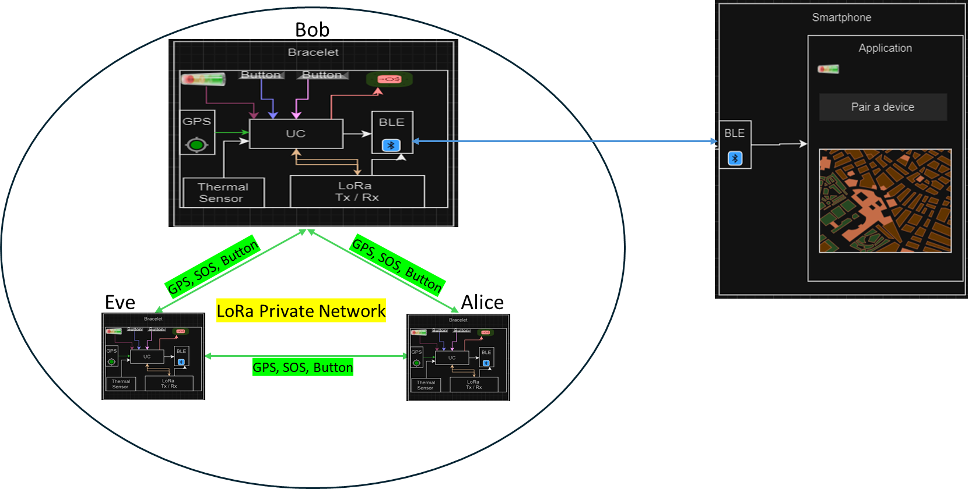
Usage scenario

Slide 5
Technical introduction
State of the art :
Location of group members
Drones | Traditional methods
Satellites | Applications

Slide 6
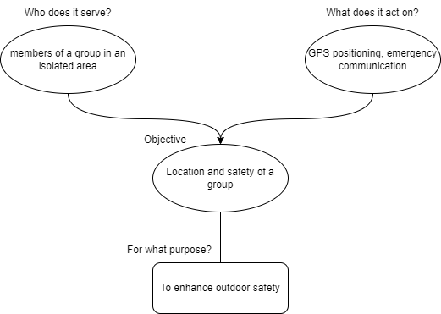
Technical introduction
Functional Analysis

Slide 7
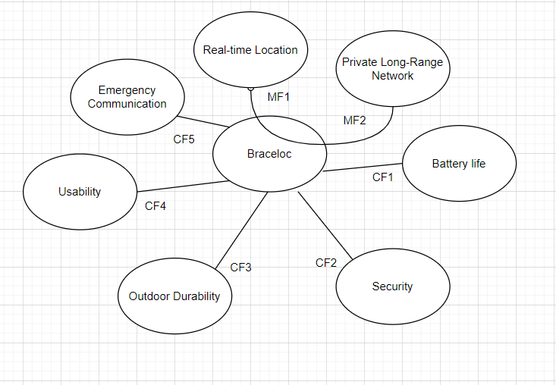
Technical introduction
Functional Analysis:

Slide 8
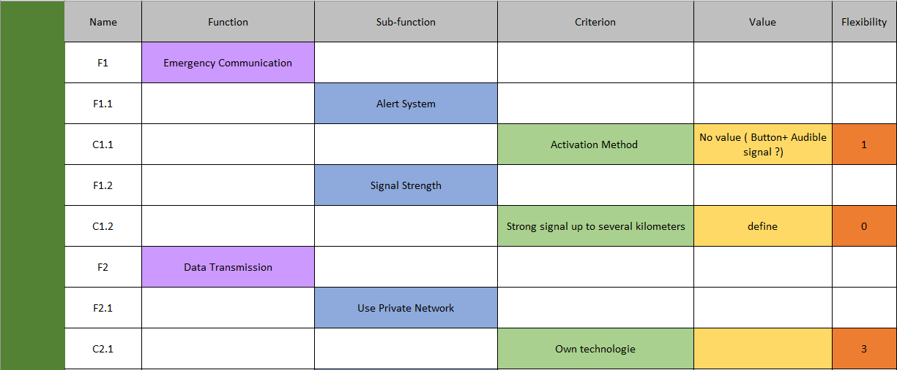
Technical introduction

Slide 9
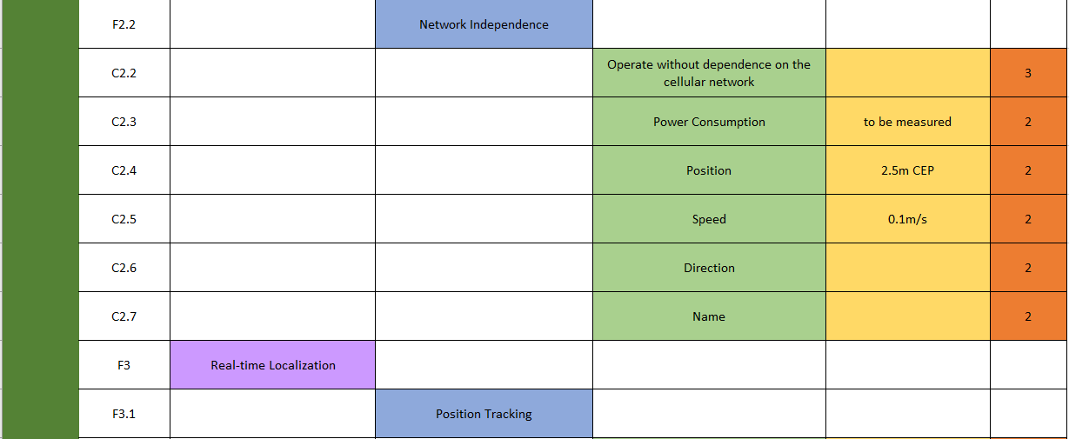
Technical introduction

Slide 10
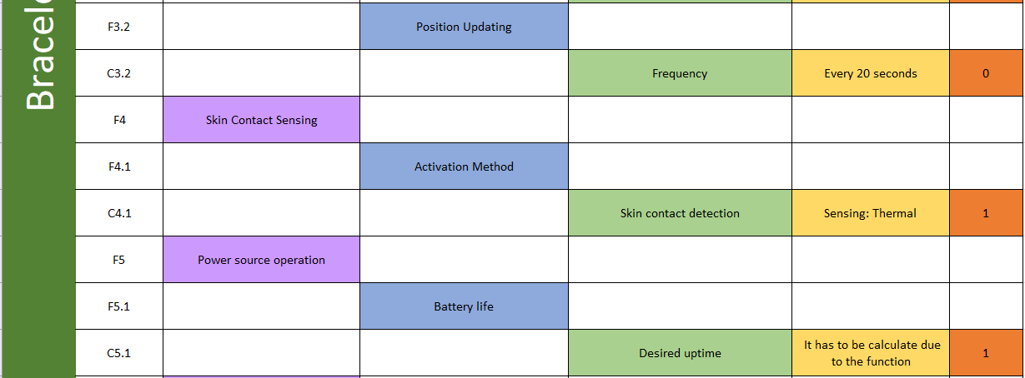
Technical introduction

Slide 11
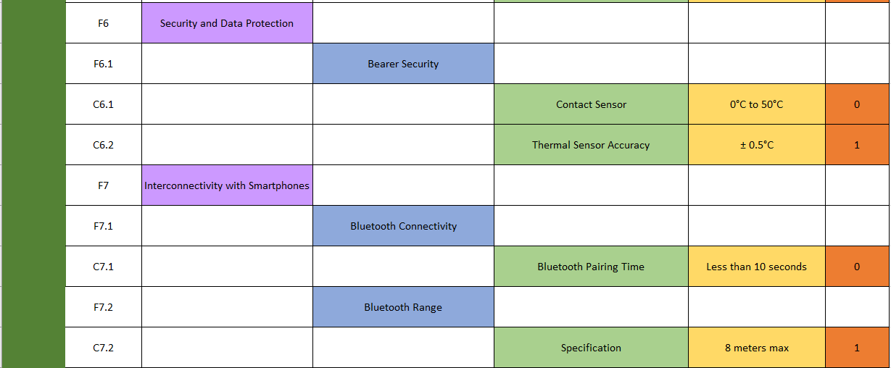
Technical introduction

Slide 12
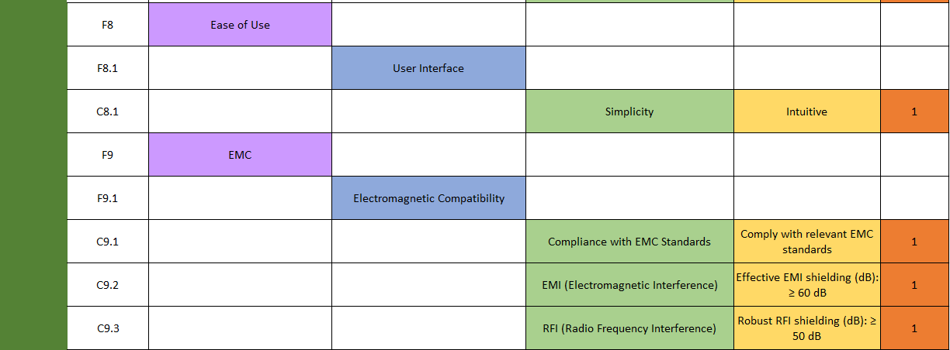
Technical introduction

Slide 13
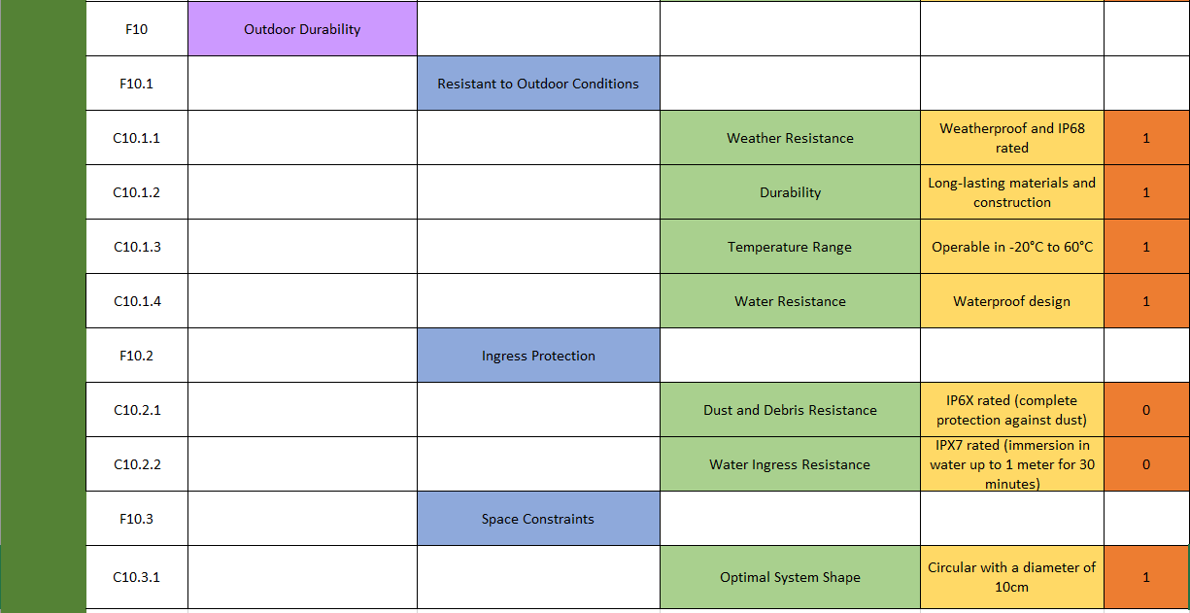
Technical introduction

Slide 14
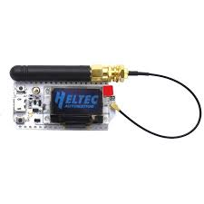
Technical solutions implemented: the LoRa communication protocol
Objective: Establish decentralized communication between two LoRa32 V3 Heltec modules using a private LoRa mesh network
Communication Parameters:
Frequency: 868 MHz (Europe).
Power: 10 dBm.
Data rate: 10 kbps.
Configure modules as network nodes.
Testing and Validation:
Verify range: 1 km (urban), 5 km (rural).
Assess communication reliability.

Slide 15


Introduction to LoRa and Meshtastic
LoRa: Long-Range, Low-Power Communication
Long Range: Ideal for smart cities, agriculture, and industrial monitoring.
Low Power: Prolongs battery life significantly.
Adaptive Data Rate: Efficient communication based on signal strength.
Meshtastic: LoRa-Powered Mesh Network
Mesh Networking: Decentralized, self-healing network.
Communication: Text messages, GPS data, even without cellular networks.
GPS Integration: Share location within the mesh.

Slide 16
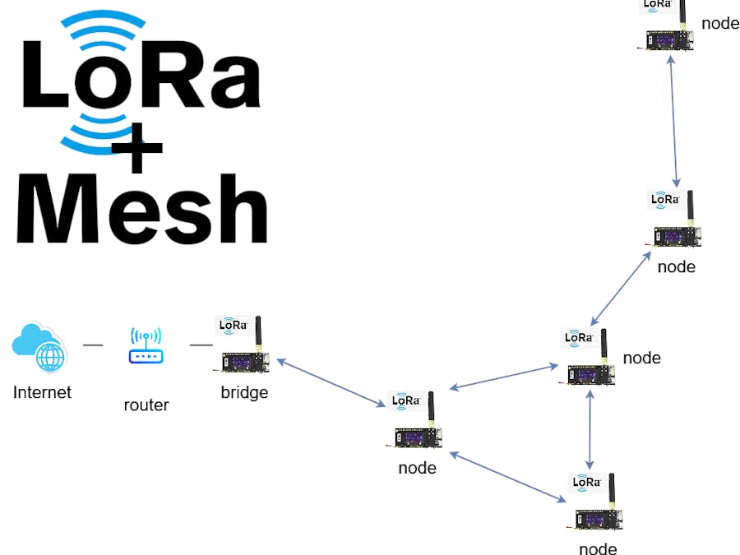
What is a Mesh Network?
Objective : Establish a self-healing, self-configuring LoRa mesh network
for long-range communication
Setup: ESP32 nodes require unique IDs and specific LoRa settings, such as transmission power and frequency.
Mesh Testing: Testing involves distancing nodes until connection is lost, then reintroducing a midway node to restore communication.
Airtime Management: LoRa's long range means low data rates and extended airtime, influenced by bandwidth and spreading factor.
Channel Activity Detection: LoRa modules can detect channel activity for efficient communication, though some library limitations exist.

Slide 17
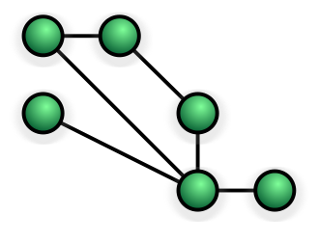
Communication in LoRa Mesh Network
Decentralized local area networks
Infrastructure nodes connect directly
Self-organize and configure dynamically
Reduce installation complexity
Enhance fault-tolerance
Lack universal standards among vendors
Employ flooding or routing techniques
Self-healing algorithms ensure continuous connections
Fully connected mesh networks offer increased security and reliability
Higher cabling costs with increased nodes

Slide 18
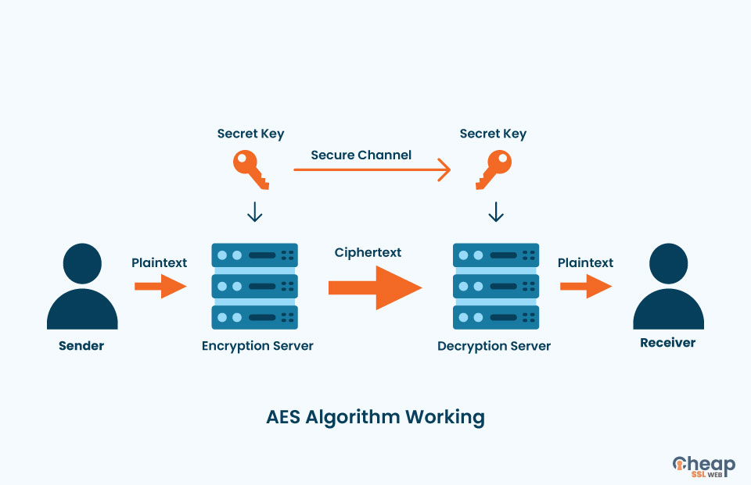
Technical solutions implemented: Advanced Encryption Standard
widely used symmetric encryption for securing data
same key is used for both encrypting and decrypting data
This means that the different connected bracelets will possess the same key to encrypt data when sending and decrypt data when receiving.

Slide 19
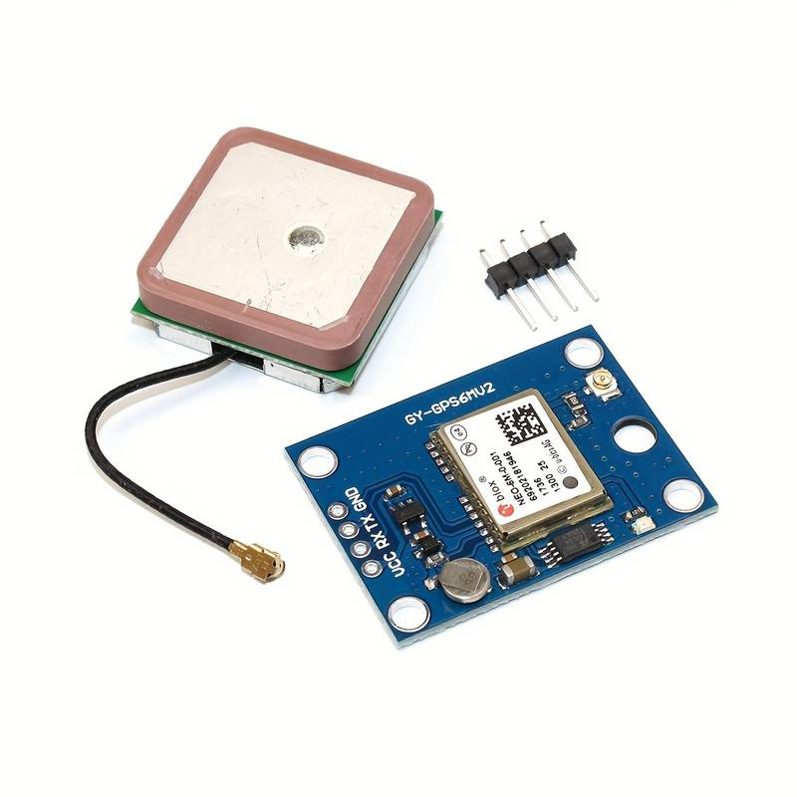
Technical solutions implemented: GPS sensor
Receiver Sensitivity: -162dBm tracking, -148dBm acquisition
Power Consumption: 50mA at 3.3V
Communication Interface: UART, default baud rate of 9600 bps
Backup Battery: Rechargeable 3.3V lithium-ion battery, 110mAh
Satellite Systems Support: GPS, GLONASS, Galileo
Frequency: L1, 1575.42 MHz
Accuracy: Position accuracy of 2.5m CEP, Velocity accuracy of 0.1m/s
Operating Voltage: 2.7V to 3.6V
Operating Temperature: -40°C to +85°C

Slide 20
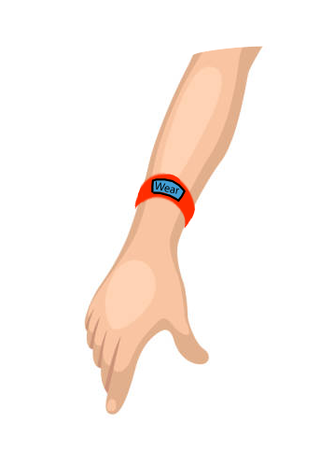
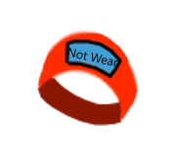


Technical solutions implemented: Skin Detection Sensor
Objective: Verify that the bracelet is properly worn by the user
Not wear
Wear

Slide 21
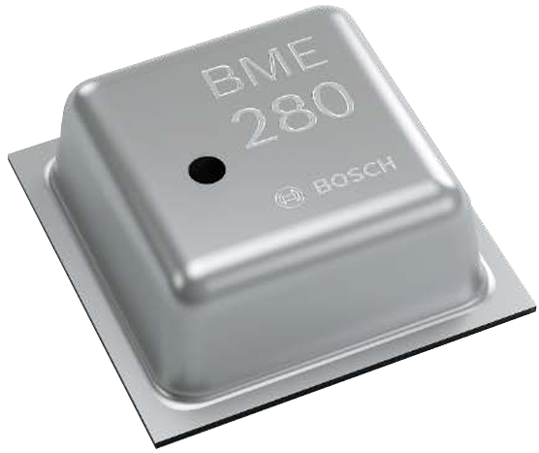
Skin Detection Sensor
Pressure, temperature, humidity sensor.
Supply current: 500 nA
Operating Voltage: 3.3V
Weight: 55 mg
communication protocols: I2C, SPI
Package: 2.5 mm x 2.5 mm x 0.93 mm
Operating range : -40 to +85 °C | 0 to 100 % humidity | 300 to 1100 hPa

Slide 22
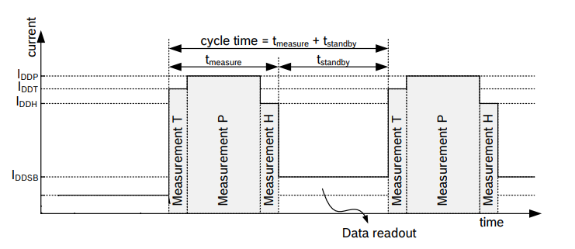
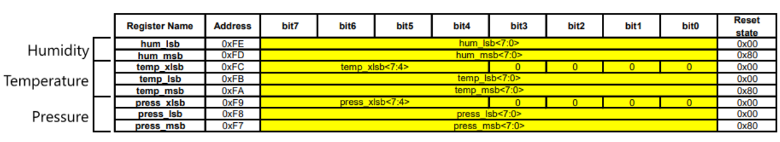
Data acquisition and reading
Measurement timing diagram
Memory map

Slide 23
Task allocation LORA
Name | Task | Task validity condition | Start Date | End Date | Project duration (hours). | In charge
LoRa |  | Evaluating the performance of the mesh network, including latency, data throughput, and power consumption. Identifying bottlenecks and potential improvement areas to optimize the overall network performance. Validating the maximum data transmission distance. | 2/26/2024 | 3/15/2024 |  | Nicolas Florian Helioth
 | Understanding the operation of the LoRa network | Ability to explain modulation principles, frequency ranges, and transmission characteristics specific to the LoRa network. | 2/26/2024 | 2/29/2024 | 3
 | Configure PlatformIO | Correct configuration of PlatformIO for the target board type and specific development environment (No errors related to PlatformIO). | 2/27/2024 | 2/27/2024 | 2
 | Communicate with the board | Ability to upload code to the board and interact with it via PlatformIO. | 2/27/2024 | 2/27/2024 | 1
 | Displaying text on the screen | Successful testing to confirm the display of text on the board's screen. | 2/27/2024 | 2/27/2024 | 1
 | Repeating the first two steps with a second card | Second card configuration without errors and verification of its ability to communicate with PlatformIO | 2/27/2024 | 2/27/2024 | 1
 | Sending and receiving simple data ('Hello World') on each of the two cards. | Successful sending of the 'Hello World' message from one board and successful reception on the other board, and vice versa. | 2/28/2024 | 2/29/2024 | 4
 | Designing the network architecture: Define the topology of the mesh network by determining how the nodes will be interconnected. | Detailed documentation describing the mesh network topology, including the connection diagram between nodes | 2/29/2024 | 2/29/2024 | 2

Slide 24
Task allocation LORA
Name | Task | Task validity condition | Start Date | End Date | Project duration (hours). | In charge
 | Installing LoRa Libraries: Use PlatformIO to install the necessary LoRa libraries for our development board | Verification of the correct integration of libraries and dependencies in PlatformIO. | 2/29/2024 | 2/29/2024 | 1
 | Defining LoRa Parameters: Configure LoRa parameters such as frequency, transmission power, data rate, and spreading factor | Validation of configured parameters through data transmission and reception tests. Optimize various parameters to maximize the transmission distance as much as possible | 2/29/2024 | 2/29/2024 | 2
 | Implementation of Basic Code: Start by writing basic code that initializes the LoRa module on each device in the network. Define functions for LoRa message transmission and reception. Implement mesh logic so that each device can relay messages from other devices | Successful development of a basic code initializing LoRa modules on each device in the network. Functional implementation of LoRa message transmission and reception functions. Successful integration of mesh logic to enable message relay between devices. | 3/1/2024 | 3/1/2024 | 4
 | Network Topology Management: Design a mechanism to manage the network topology, including dynamic addition and removal of nodes. Ensure that each node is aware of its neighbors to transmit messages efficiently within the mesh network |  | 3/1/2024 | 3/1/2024 | 3

Slide 25
Task allocation GPS Sensor
Name | Task | Task validity condition | Start Date | End Date | Project duration (hours). | In charge
GPS sensor. | Initialization of the GPS sensor: Write the necessary code to initialize the GPS sensor at the startup of the Heltec WiFi 32 LoRa module. Send the appropriate initialization commands to the GPS sensor via the serial port to set it in operational mode. | Use the serial monitor to check the connection between the GPS sensor and the Heltec WiFi 32 LoRa module | 2/29/2024 | 2/29/2024 | 1 | Florian
 | Receive and process GPS data: Develop the code to receive position data transmitted by the GPS sensor via the serial port. Analyze the received data to extract position information such as latitude, longitude, and optionally speed and direction. | Validate the accuracy of the position data provided by the GPS sensor by comparing it with the datasheet. | 2/29/2024 | 2/29/2024 | 1 | Florian

Slide 26
Task allocation Smartphone Application + BLE
Name | Task | Task validity condition | Start Date | End Date | Project duration (hours). | In charge
Smartphone Application + (BLE) | Create a mobile application that will allow connecting to Braceloc bracelets via Bluetooth Low Energy (BLE). Design an intuitive user interface to visualize the positions of the group and manage bracelet settings. | Connection test to verify that the application can detect and connect to Braceloc bracelets via Bluetooth BLE, ensuring that the connection is stable and reliable. | 3/13/2024 | 4/23/2024 | 27 | Nicolas Florian
 | Integrate configuration and pairing functionalities for the bracelets into the application. | Verification through authentication tests to confirm that the application can check the credentials of Braceloc bracelets during the pairing process, ensuring that only authorized bracelets can be paired with the application. | 3/23/2024 | 4/6/2024 | 7
 | Integrate into the application the functionality to connect with heltec wifi lora v3 via Bluetooth Low Energy (BLE). | Conduct tests on the stability and reliability of the Bluetooth Low Energy (BLE) connection. | 4/6/2024 | 4/9/2024 | 3
 | Program the application to receive and display the position data transmitted by the bracelets. | Verify through tests to ensure that the received position data is correctly extracted from the BLE data stream and interpreted by the application. | 4/9/2024 | 4/23/2024 | 17

Slide 27
Task allocation Security of data transmission
Name | Task | Task validity condition | Start Date | End Date | Project duration (hours). | In charge
Security of data transmission | Configuration of security parameters: Defining appropriate security parameters, such as encryption algorithms, encryption keys, identity verification parameters, and authentication methods. |  | 2/28/2024 | 3/6/2024 | 2 | Helioth
 | Encryption Implementation: Integrating encryption mechanisms within the application and the bracelets to encrypt the exchanged data. |  | 3/12/2024 | 3/16/2024 | 2 | Helioth
 | Encryption Key Management: Establishing a secure system for generating, storing, and managing encryption keys. Utilizing key management protocols such as Key Management Interoperability Protocol (KMIP) to ensure key security. | Verify that it is impossible to decode the transmitted data (Key length and complexity of encryption keys).
 | Device Authentication: Develop authentication mechanisms to verify the identity of Bluetooth BLE devices during the establishment of the connection. This may include the use of digital certificates or unique identifiers for each device. | Verify that unauthorized connection attempts are rejected. | 3/16/2024 | 3/18/2024 | 1 | Helioth

Slide 28
Task allocation Skin Detection Sensor
Name | Task | Task validity condition | Start Date | End Date | Project duration (hours). | In charge
Skin Detection Sensor |  |  | 3/11/2024 | 3/25/2024 | 23 | Nicolas
 | Learn the operation of the BM280 sensor |  | 3/11/2024 | 3/12/2024 | 3
 | Create a prototype circuit for using the BM280 sensor | Sending data to the ESP32 | 3/18/2024 | 3/20/2024 | 4
 | Write code to retrieve data from the sensor (temperature, humidity, pressure). | Consistency between the sensor data and the actual values. | 3/18/2024 | 3/22/2024 | 8
 | Finding parameters for simulating the wearing of the bracelet to determine if it is properly worn by the user. | When in contact with the skin, the sensor should send information to the microcontroller (uC), which should consider that the bracelet is being worn. | 3/18/2024 | 3/25/2024 | 8

Slide 29
Conclusion
Integrate GPS, 1 or 2 buttons, and 1 or 2 LEDs.
Include BLE and pairing function to transmit information to a smartphone (ensure proper reception of GPS, button, battery, zone limit/RSSI).
Develop the smartphone application (map, alerts, etc.).
Incorporate a skin detection sensor

Slide 30
Thank you for your attention

